Slide 1

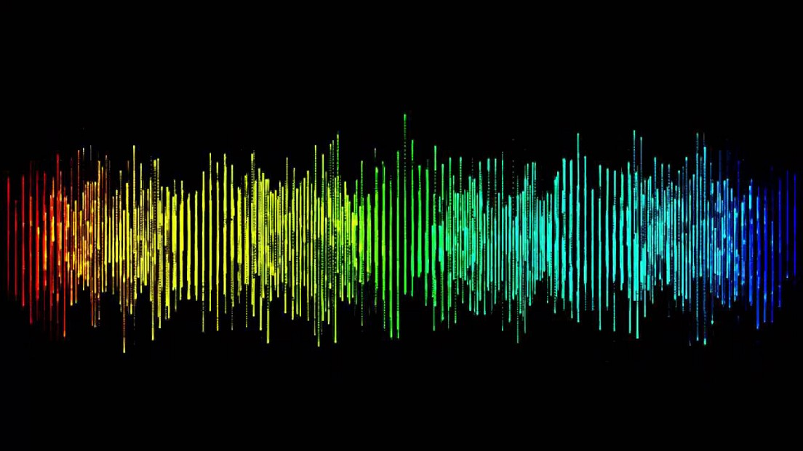
OBJECT DETECTION FROM SOUND
Team Members-
Sirun
Eshwar
Vineet
Shiven

Slide 2
Summary
Object detection from sound uses audio signals to identify objects in an environment. This technique is known as echolocation and is used by animals such as bats and dolphins. Researchers are developing machine learning models to perform object detection from sound, which has applications in robotics, autonomous vehicles, and surveillance systems.
Applications of object detection from sound include robotics, autonomous vehicles, and surveillance systems. For example, a robot equipped with echolocation sensors can navigate its surroundings and identify obstacles, while a surveillance system can use echolocation to detect intruders in a dark environment.

Slide 3

Dataset
UrbanSound8K
This dataset contains 8732 labeled sound excerpts (<=4s) of urban sounds from 10 classes: air_conditioner, car_horn, children_playing, dog_bark, drilling, enginge_idling, gun_shot, jackhammer, siren, and street_music.
https://urbansounddataset.weebly.com/download-urbansound8k.html

Slide 4
Libraries
Librosa
Librosa is a Python library used for audio and music signal processing, including feature extraction and spectrogram generation.
Matplotlib
Matplotlib is a Python library used for creating static, animated, and interactive visualizations in Python.
NumPy
NumPy is a Python library used for scientific computing and working with arrays, including mathematical operations on arrays and matrices.

Slide 5
Pandas
Pandas is a Python library used for data manipulation, organization, and analysis, including working with tabular data and time-series data.
Seaborn
Seaborn is a Python library used for statistical data visualization, providing a high-level interface for creating informative and attractive visualizations.
TQDM
tqdm is a Python library used for adding progress bars to iterables, allowing you to track the progress of a loop or operation.

